Slide 1

StrongLoop
Mani Teja Manduri
API Management,
Miracle Software Systems.

Slide 2
What is StrongLoop?
Loopback
StrongLoop Lifecycle

Slide 3
What is StrongLoop?
StrongLoop is an American company working with Node.js
to create and support StrongLoop Suite, an API Tier.
API Tier:It acts as a natural bridge between front end
and back end.
The main benefit of adding a Node.js framework is to address a
demand from enterprises who are interested in building apps with
APIs that can handle large amounts of data and also connect on
the back-end with other enterprise applications.

Slide 4
LoopBack
LoopBack is a highly-extensible, open-source Node.js framework.
Quickly create dynamic end-to-end REST APIs.
Connect devices and browsers to data and services.
Use StrongLoop Arc to visually edit, deploy, and monitor LoopBack apps.
Runs on-premises or in the cloud

Slide 5
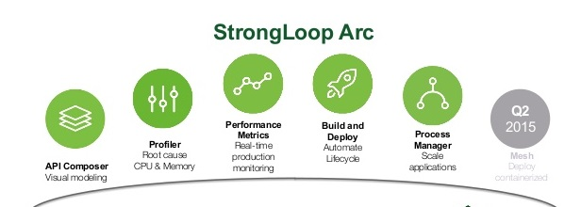
StrongLoop Solutions for API Lifecycle

Slide 6
API Composer
Compose APIs and get them connected to your data.
Create and modify models and data sources.
Discover models from data sources.
Profiler
Profiler module enables you to generate and view:
Application CPU profiles.
Application heap snapshots to help diagnose memory leaks.
Metrics
Metrics module enables you to gather and view performance
metrics on your application.

Slide 7
Build and Deploy
StrongLoop Arc Build and Deploy enables you to build and
deploy Node applications to local or remote system.
Multi-host deploy
Deploy multiple applications to one Process Manager
Process Manager
Process Manager module enables you to manage an application
running in clustered mode across multiple server hosts.
Automatic restart on failure.

Slide 8
Tracing
The StrongLoop Arc Tracing module enables you to analyze
performance and execution of Node applications and to trace
code execution paths.
Gateway
The StrongLoop API Gateway externalizes, secures, and manages
APIs. It acts an intermediary between API consumers (clients)
and backend API providers (API servers).
Using Arc, you can define policies, pipelines, and mappings.

